Slide 1
WCF and rest services

Slide 2

Mobile Solution Design Planning
▪
▪
▪
▪
▪
▪
▪
▪

Slide 3
Exposing Mobile Friendly Web APIs

Slide 4
WCF vs. ASP.NET Web API
WCF | ASP.NET Web API
Multiple transport protocols (HTTP, TCP, UDP, and custom transports) | HTTP only. First-class programming model for HTTP
Multiple encodings (Text, MTOM, and Binary) of the same message | Wide variety of media types including XML, JSON etc.
WS-* standards like Reliable Messaging, Transactions, Message Security | Basic protocol and formats such as HTTP, WebSockets, SSL, JQuery, JSON, and XML
Request-Reply, One Way, and Duplex message exchange patterns | HTTP is request/response but additional patterns can be supported through SignalR and WebSockets
WCF SOAP services can be described in WSDL, generate client proxies | Many ways to describe: Auto-generated HTML help page describing snippets to structured metadata for OData integrated APIs
Ships with the .NET framework | Ships with .NET framework, open-source, available out-of-band

Slide 5



Exposing Mobile-friendly Web APIs
▪
▪
▪
▪
▪

Slide 6
Demo:
ASP.NET Web API Design Samples

Slide 7







Mixing On-Premises and Cloud Assets
▪
▪
▪
▪
▪
▪
▪
▪
▪
▪
▪
https://www.microsoft.com/en-us/cloud-platform/hybrid-cloud

Slide 8

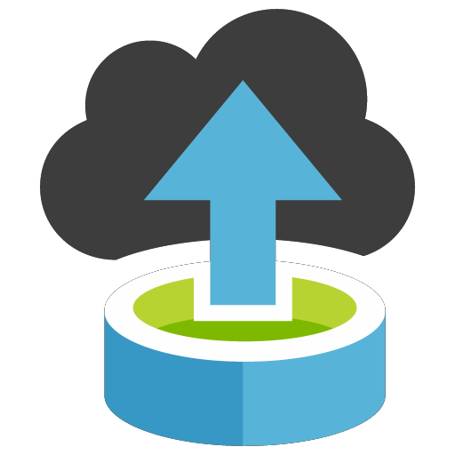





Migration Tools & Services
Assess
Migrate

Slide 9
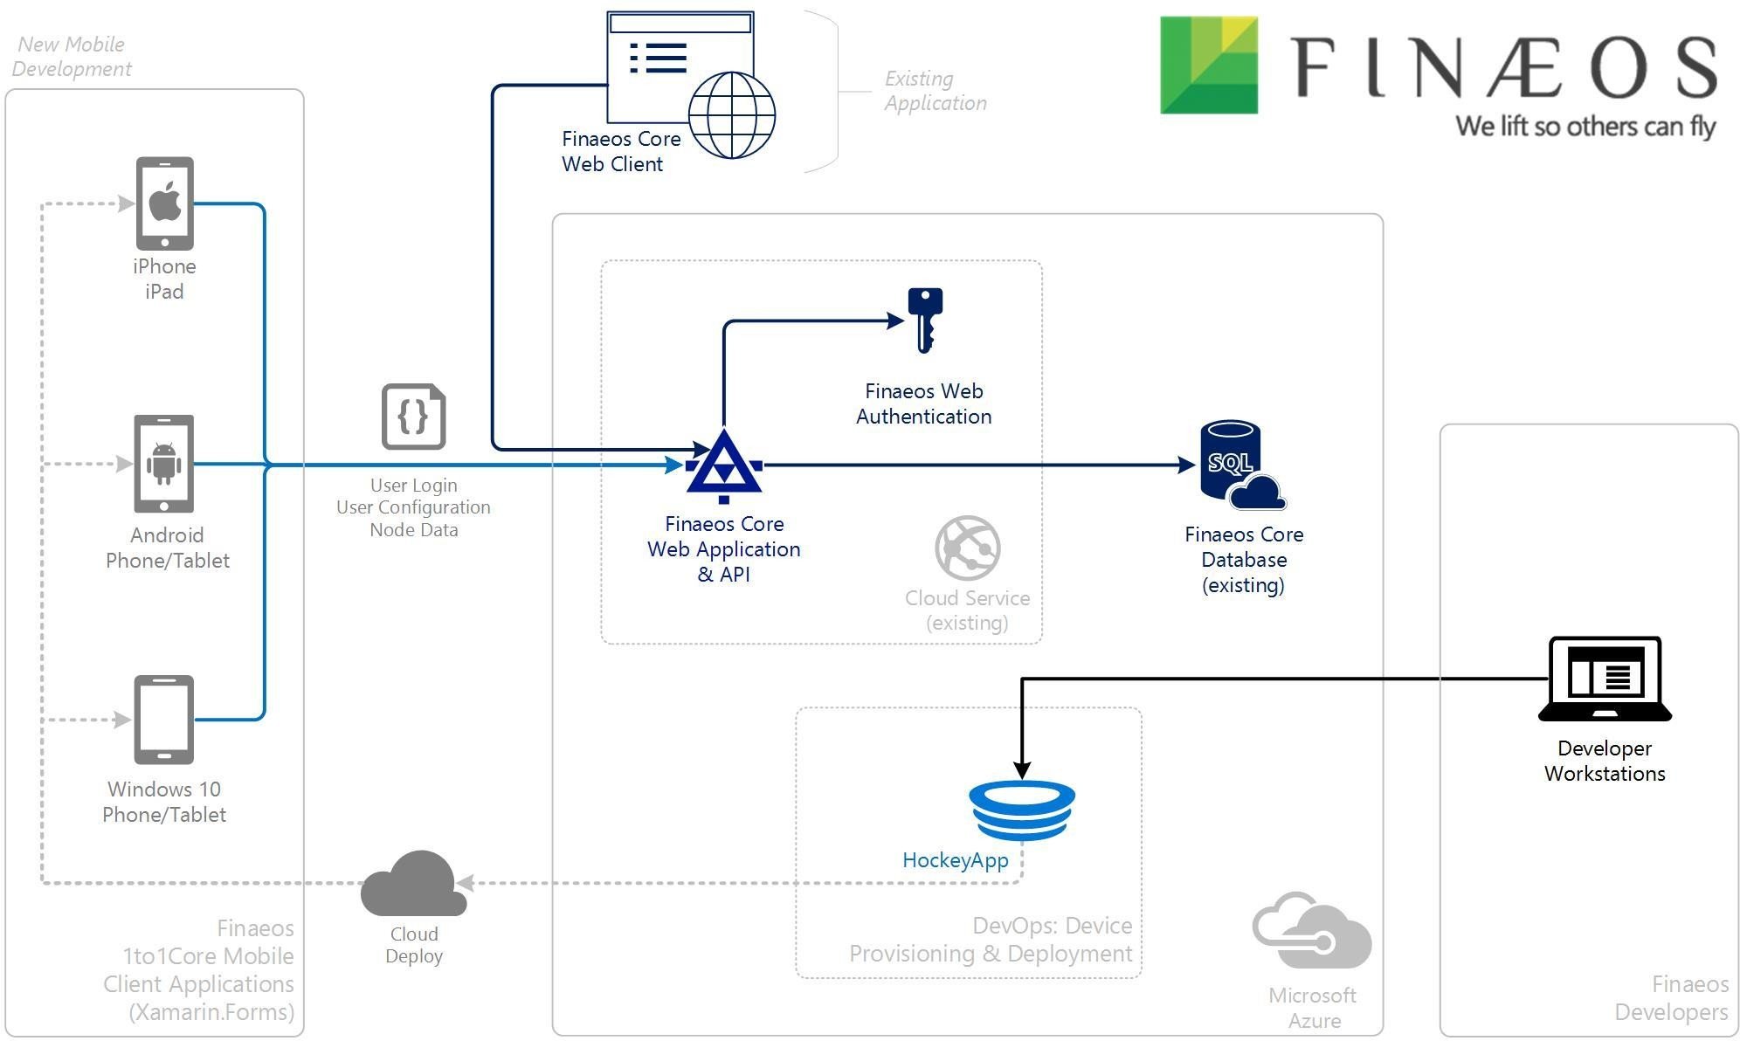
Sample Architecture: Finaeos 1to1Core

Slide 10



Authentication & Authorization
▪
▪
▪
▪

Slide 11












Our vision
An ideal identity system…
Reaches the audience you want
Has great fundamentals
Every da_{D}y_{e}t_{f}h_{lec}i_{t}d₁en.t₅ity_{M}ML
Identify 30K
system processes
attacks perpdoateynintiatlhlye
10TB coocnofsmumpdreoramsptisaeacde
users per day
Works great with your solution

Slide 12









Production-ready MSAL previews
▪
▪
▪
▪
▪
▪
▪
▪
▪
▪

Slide 13
Demo:
Microsoft Authentication Library (MSAL)

Slide 14








Azure Active Directory B2C
Reach any user, on any platform
Select from a set of built-in, self-service identity
experiences
Customize each pixel. It’s your brand, your HTML
and CSS
Scale to 100s of millions of user accounts Run on the same secure, highly available
infrastructure that powers O365 authentications

Slide 15
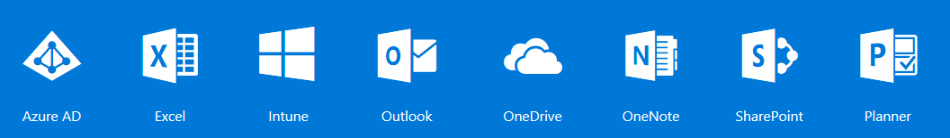

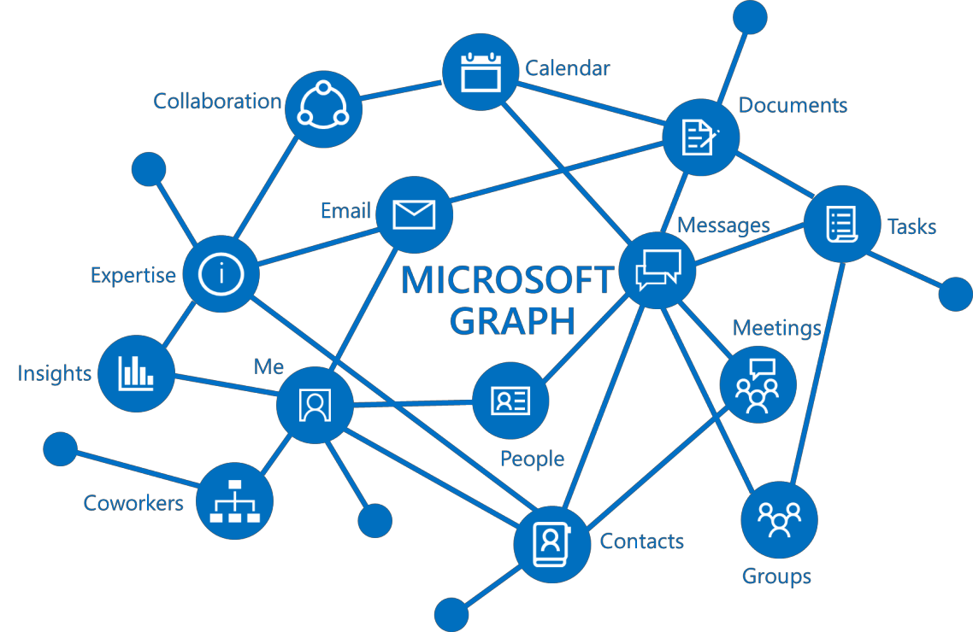
Microsoft Graph
HTTPS://GRAPH.MICROSOFT.COM
Single API that proxies multiple Microsoft services
Allows for easy traversal of objects and relationships
Eliminates the need to discovery endpoints Only one OAuth access token needed
For both personal and work and school accounts
Exposing User data, Group data and Organizational data

Slide 16

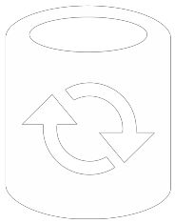

Data Synchronization & Offline Access
▪
▪
▪
▪
▪
https://blog.xamarin.com/getting-started-azure-mobile-apps-easy-tables/

Slide 17
Create a Mobile Service
MobileService = new MobileServiceClient( "https://myapp.azurewebsites.net");

Slide 18
Create Tables
IMobileServiceSyncTable<Store> table; public async Task Init()
{
const string path = "syncstore.db";
var db = new MobileServiceSQLiteStore(path); db.DefineTable<Store>();
var handler = new MobileServiceSyncHandler();
await MobileService.SyncContext.InitializeAsync(db, h); table = MobileService.GetSyncTable<Store>();
}

Slide 19
Get and Modify Data
public async Task<IEnumerable<Store>> GetStoresAsync()
{
await table.PullAsync("allStores", table.CreateQuery()); return await table.ToEnumerableAsync();
}
public async Task<Store> AddStoreAsync (Store store)
{
await table.InsertAsync (store);
await table.PullAsync("allStores", table.CreateQuery()); await MobileService.SyncContext.PushAsync();
return store;
}

Slide 20




From Mobilize to Modernize
▪
▪
▪
▪
▪
▪

